Slide 1


Bioscience Careers in Manitoba
Notes:
Training & Education Liaison
Manager, Training & Development
Bioscience Association Manitoba

Slide 2
bioscience (noun)
any of the areas of scientific study that relate to living things
Bioscience companies :
manufacture
process
provide services
distribute
conduct research and development
Notes:
So what is BIOSCIENCE??
It is any of the areas of scientific study that relate to living things
Bioscience Companies manufacture, process, distribute (wholesale and retail), provide services (various consulting and testing) and conduct research and development. Often, bioscience companies will operate in more than one industry or type of operation.

Slide 3

We are the voice of Manitoba’s bioscience industry
We are passionate advocates for the bioscience community
We are committed to the success of our members
Notes:
BAM represents over 100 local companies who are all engaged in the bioscience industry
We are their voice, advocates, and are committed to their success

Slide 4

Our Mission
To enable commercial success for Manitoba’s bioscience companies by acting as a catalyst for innovation, by expanding the sector’s skills and workforce development, and by leading with one unified voice to create local and global engagement.
Notes:
MISSION
To help our companies achieve commercial success and being the catalyst by helping expand workforce skills development and helping create a unified voice in the global market

Slide 5
Our Vision
To cultivate a vital bioscience community that drives economic growth for Manitoba.
Notes:
VISION
To help cultivate the community that drives economic growth for the bioscience industry in Manitoba.

Slide 6
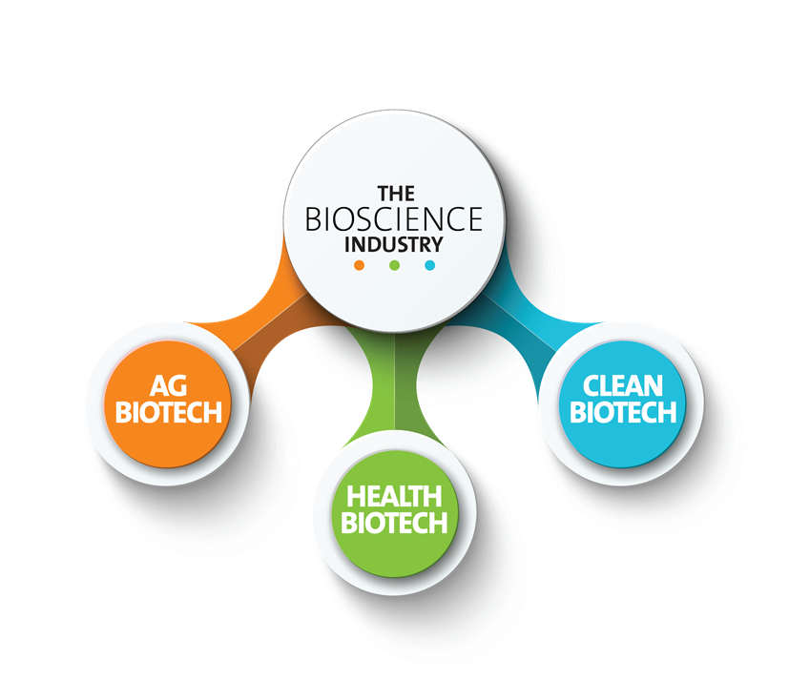
BIOHEALTH
Notes:
The Bioscience Industry can be divided into 3 sub sectors:

Slide 7
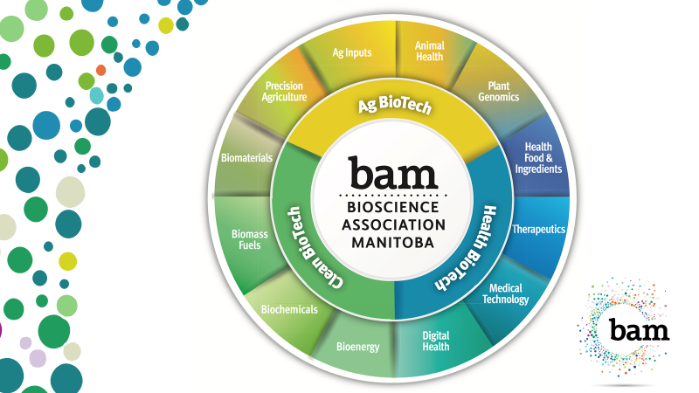

Slide 8
AG BIOTECH
Plant Genomics
Animal Health
Ag Inputs
Precision Agriculture

Slide 9
BIOHEALTH
Healthy Food and Ingredients
Medical Technology
Therapeutics
Digital Health

Slide 10
CLEAN BIOTECH
Bioenergy
Biochemicals
Biomass Fuels
Biochemicals
Biomaterials

Slide 11


Jobs/Careers that might interest you

Slide 12


research scientist, biologist, chemist
Biological Science
Microbiology
horticulturalist, biochemist, agriculture technician, biological technician

Slide 13

Biosystems Engineering
Environmental protection, food safety, medical devices, alternative energy production, agriculture equipment
Environmental Science
environmental chemistry and
biogeochemistry, environmental manager

Slide 14

Agribusiness
careers with grain companies, government agencies,
banks and credit unions and agriculture dealers
Food Sciences
food chemistry and microbiology, product development, consulting, research, nutrition, quality control and inspection

Slide 15
Computer Science
Information system analysts, software developers, research scientists, big data, finance, digital technology for healthcare, artificial intelligence, robotics and nanotechnologies, virtual reality techs
As in most industries, there are also career opportunities for managers, supervisors, HR and training consultants, marketing and communications and many other positions in these companies.
Notes:
Computer science offers skills in problem solving and opens doors to many career opportunities in bioscience - Information system analysts, software developers, research scientists, big data, finance, digital technology for healthcare, artificial intelligence, robotics and nanotechnologies, virtual reality techs.
As in most industries, there are also career opportunities for managers, supervisors, HR and training consultants, marketing and communications and many other positions in these companies.

Slide 16
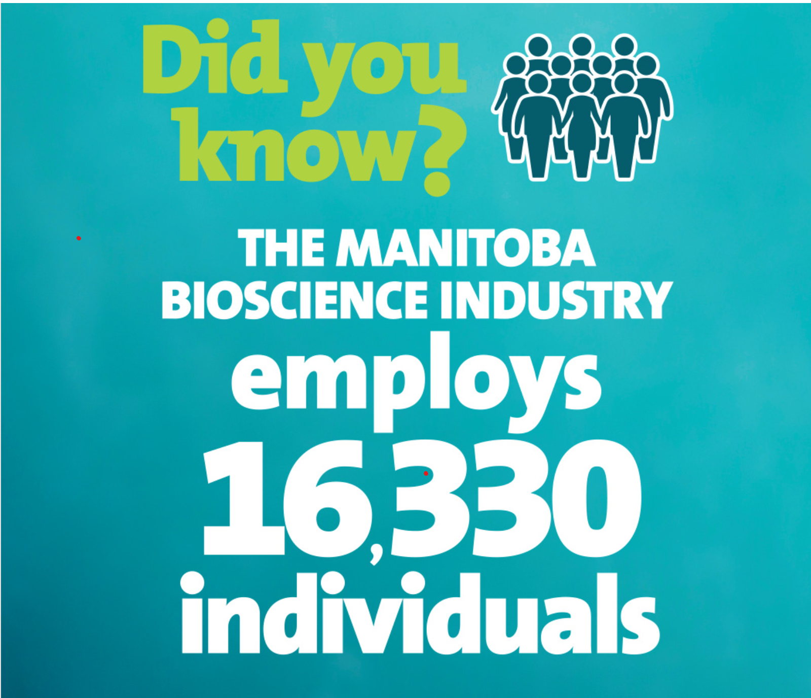

Slide 17


Slide 18

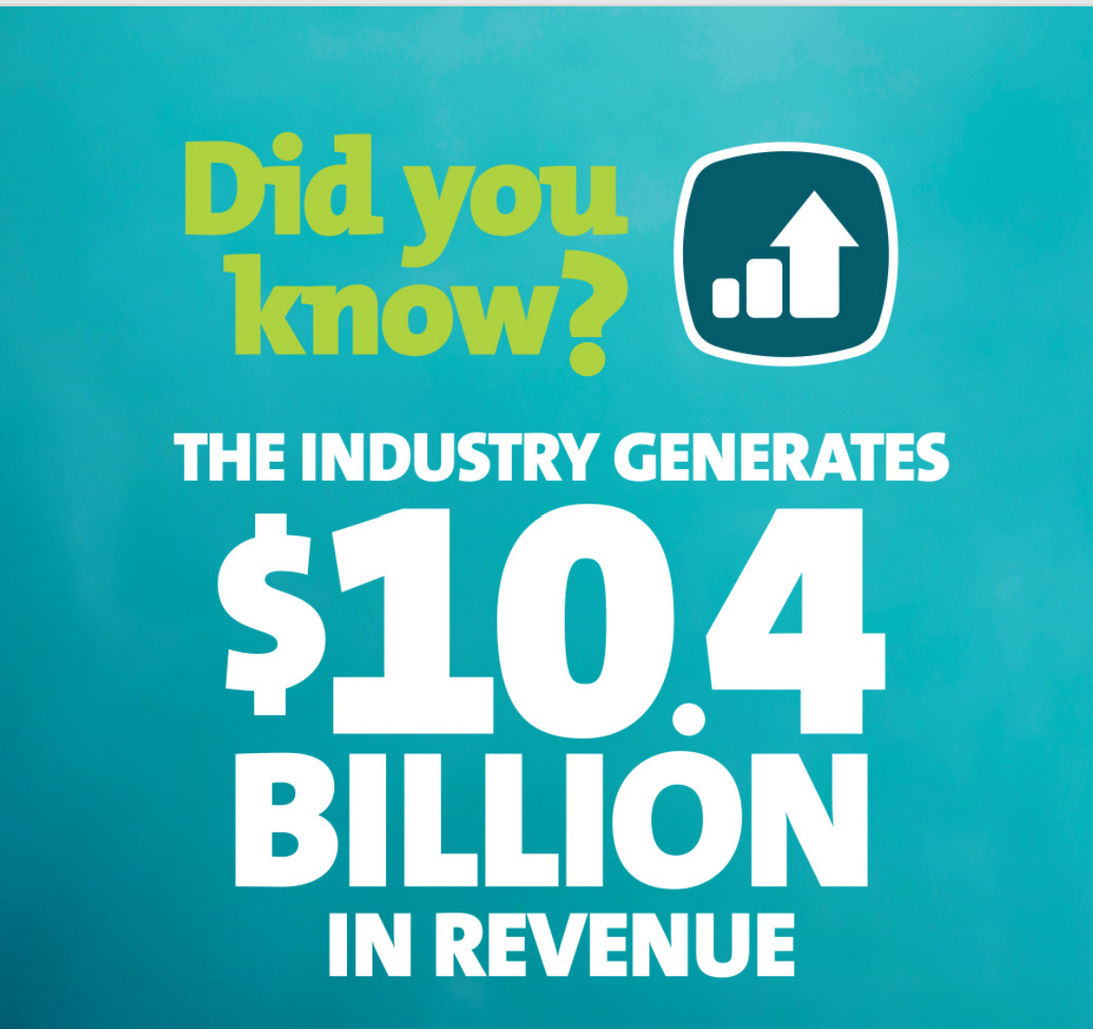

Slide 19


Slide 20


Slide 21
Personalities or Qualities that Match:
Interest in Science
Complex problem solving
    Critical thinking
Reading comprehension
Mathematics skills
Writing skills
Judgement and decision making
Speaking skills
Ability to work in a team
Active listening

Slide 22
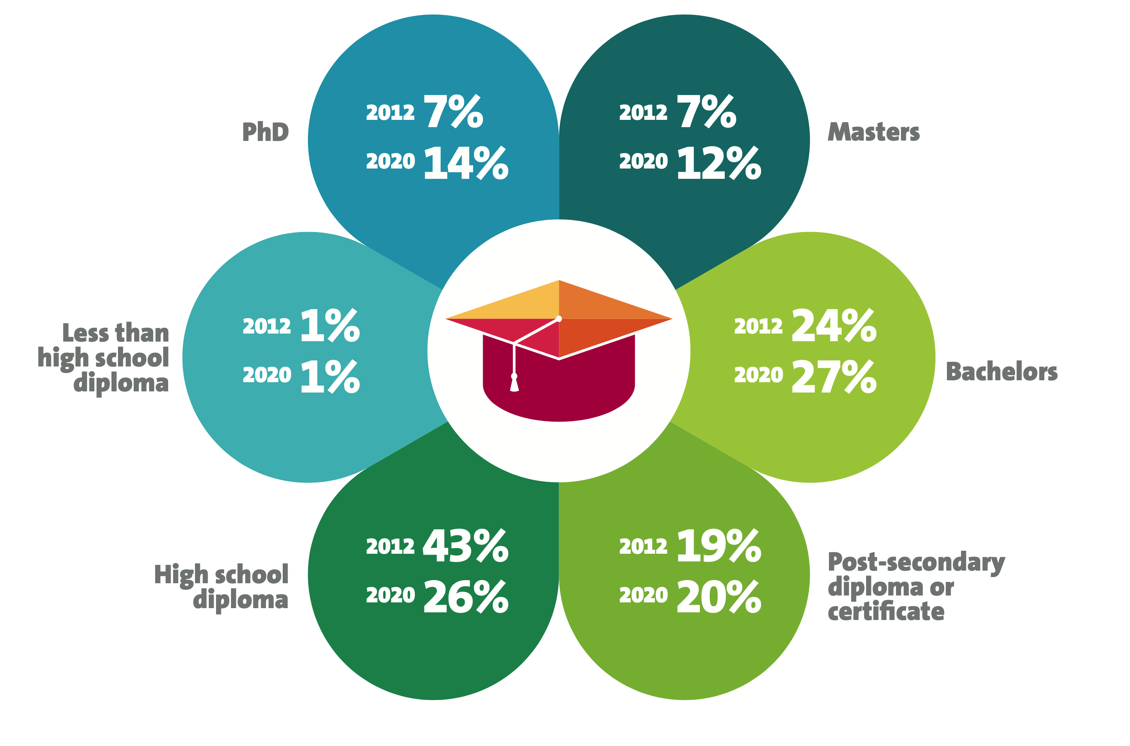

Notes:
Here is some information on the number of jobs in the industry based on levels of education, comparing numbers from 2012 to 2020, which is the most recent information available:
1% of workers in the industry have achieved less that a high school diploma – which hasn’t seen any change since 2012
In 2012, 43% of the jobs were held by employees whose highest education level was a high school diploma. This has fallen to 26% - so there are fewer jobs available in the industry to workers who highest education is high scholl.
In 2012, 19% had a diploma or certificate, and the number has increased by 1% to 20%, which supports the fact that a college degree continues to provide good opportunities for employment in the bioscience sector.
The opportunities for students with bachelor degrees has increased by 3% since 2012, from 24% to 27%.
That is also the case for masters degrees, up to 12% from 7%, and PHDs up from 7% to 14%

Slide 23
Where do I go from here?
University of Manitoba
University of Winnipeg
Red River College
Manitoba Institute of Trades and Technology (MITT)
Universite de Saint-Boniface
Canadian Mennonite University (CMU)
Assiniboine Community College
University College of the North (UCN)
Robertson College
…..?

Slide 24

Notes:
We support 110 biotech companies – if you go to members, you can see them listed with brief descriptions of what they do
3 guys Green
Cerebra
Precision ADM
Tactile Robotics

