Slide 1


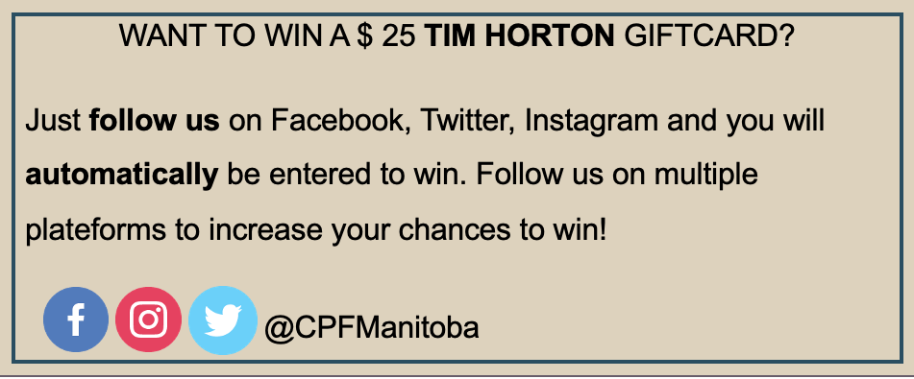
Alexandra Dénommée she/her/elle

Slide 2

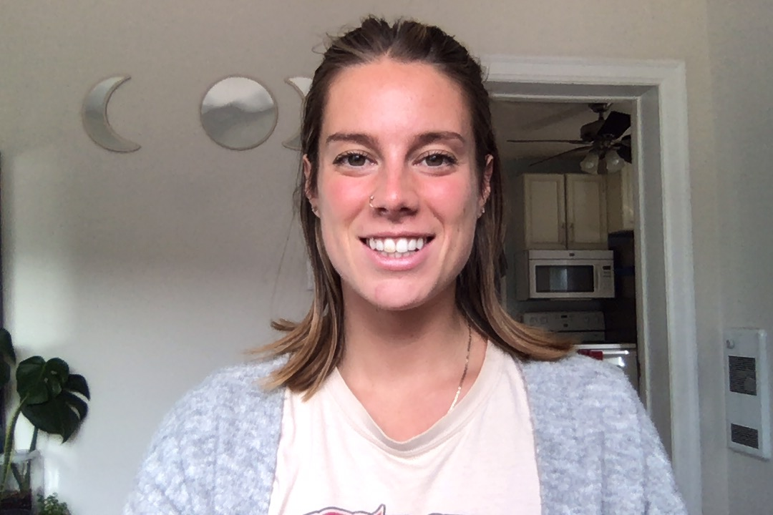
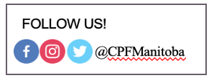
HELLO!
My name is Alexandra and I work for Canadian Parents for French Manitoba.
I am here to talk about our project Teach in French. Give the Gift of Language and Culture.

Slide 3
What is Canadian Parents for French?
Canadian Parents for French is a non-profit organization that was founded by parents in 1977 who wanted to ensure that children would have the opportunity to become bilingual in the Canadian school system. As a national organization, we are furthering bilingualism by creating and promoting opportunities to learn and use French.

Slide 4
Did you know?
In 2018, the Federal government set an objective to increase the bilingualism rate from 17.9% to 20% by 2036.
In 2015-2016, around 430,000 students were enrolled in French immersion programs in Canada, compared to 360,000 in 2011-2012.
The province said student enrolment increased by 36% in French immersion programs between 2008 and 2018.
Notes:
In 2018, the Federal government set an objective to increase the bilingualism rate to 20% by 2036 (from the existing 17.9%).
Which means that here in Manitoba, the demand for French immersion keeps growing, as parents hope to give their child the chance to learn French a second language.

Slide 5
Overview of French education in numbers
Between 2003 and 2013, Canada saw a 52% increase in French Immersion enrolment.
In Manitoba:
Education in French is growing rapidly in the province. Between 2008 and 2018, enrolment in French Immersion has increased by over 40%, to over 26,000 students.
‘’A common roadblock to increasing access to FSL programming is the shortage of qualified teachers.‘’

Slide 6
DID YOU KNOW?
How many schools in Manitoba offer the French Immersion program?
a. 58 b. 110 c. 91 d. 142
On average, what is the salary of a first-year teacher with a Bachelor of Education (according to the 2018 collective agreement)?
a. $60 470.00 b. $58 840.00 c. $64 035.00 d. $99 435.00
Based on 200 days of work and 7.5 hours per day teachers in their first year earn roughly how much per hour?
a. $32.00/hour b. $35.00/hour c. $40.00/hour d. $45.00/hour
Notes:
Response: a. $60 470.00; the average of 38 school divisions.
The answers b. and c. are the salaries of first year teachers in Garden Valley SD and Mystery Lake SD. The answer d. is the salary for a teacher with 10 years of experience in Mystery Lake SD.

Slide 7

Teaching is more
than just sharing knowledge
Teaching in French does not mean only teaching French subject.
It also means teaching science, math, music, physEd, and many other subjects, but
in FRENCH
“It’s about making a difference and impacting the lives of students for the better ’’

Slide 8





SHOW ME WHY I should become a French teacher
Are in high demand with enhanced job opportunities, security and flexibility.
Have access to scholarships, bursaries, funded exchanges and world travel.
Ignite curiosity for language and culture by creating fun, active learning environments.
Are lifelong learners, connected to a vibrant community while on a continuous learning journey.
Facilitate problem solving skills, empathy, communication skills and global citizenship.
Notes:
In high demand: High demand equals more job opportunities for you in FSL.
Schools want you. When you become an FSL teacher, you’re helping fulfill a huge need in Manitoba, and Canada-wide.
FSL teachers are one of the most sought-after education professionals, and not just as teachers but as coaches, librarians, guidance counsellors, principals, school board administration, and even Ministry of Education staff.
3. Ignite curiosity
Promoting a unique skill set
Being proficient in the French language is a unique skillset that you should be proud to have and pass on – and you can pass it on in a way that you’re passionate about

Slide 9
SHOW ME HOW To become a French teacher
Undergraduate
Degree
Apply for Manitoba Teacher certificate
Begin teaching
FSL
2
4
6
1
3
5
7
High School
Bachelor
of Education
Apply for FSL
teaching position
Ongoing professional development
Notes:
Possibility to go back and learn, to have more professional development
This will give you the opportunity to gain more skills

Slide 10





Check out some experiences that help boost French speaking-skills
Additional information
EXPLORE
ODYSEE
Improve your French
YOUNG CANADA WORK
LANGUAGES AT WORK
Notes:
OFFICIAL LANGUAGE PROGRAM
1- EXPLORE : Explore is an intensive French-immersion program that is offered during the spring and summer.
2- ODDYSSEY: Inspire youth to practice their English-speaking skills and share your culture while getting paid!
3- DESTINATION CLIC: Destination Clic is a three-week summer program tailored to help francophone youth (outside Quebec) nurture their sense of belonging to and identity with their francophone community at home and throughout Canada.
YOUNG CANADA AT WORK: give the opportunity to develop an awareness of our country's diversity, to connect with Canadians in other regions, as well as practicing their second language.
LANGUAGES AT WORK: Languages at Work is a summer employment program for youth 18 to 30 years of age designed to provide Canadian students with practical summer job experience, a chance to practice and improve their second official language skills

Slide 11





Option 1
After Degree Program (2 years) Bachelor of Education
Option 2
Integral Program (5 years)
Additional information
Get a Degree

Slide 12


Additional information
Université de Sainte-Boniface
Who: Students pursuing full-time studies at USB
What: $500 per year
Why: To encourage students to pursue their post-secondary studies in French
Scholarships available

Slide 13

Additional information
Association des Collèges et Universités de la Francophonie Canadienne
Who: English-speaking student enrolled in their first year of college or university
What: $3,000 bursary to perfect their bilinguism
Why: Allow a great number of English-speaking Canadians to become bilingual
Scholarships available

Slide 14

Additional information
Intensive French Immersion Studies Bursary
Who: Manitoba students who wants to be completely immersed in the French language and culture outside their home province
What: $1,250 per session
Why: Allow a great number of English-speaking Canadians to become bilingual
Scholarships available

Slide 15



FOLLOW US!
@CPFMANITOBA

